Slide 1
ETHEREUM BLOCKCHAIN: NEXT GENERATION SMART CONTRACT AND DECENTRALIZED APPLICATION PLATFORM
B. RAMAMURTHY
©2019, ALL RIGHTS RESERVED
BINA@BUFFALO.EDU
HTTP://WW.CSE.BUFFALO.EDU/FACULTY/BINA
TEACHING PROFESSOR
COMPUTER SCIENCE AND ENGINEERING
DIRECTOR, BLOCKCHAIN THINKLAB
PROGRAM DIRECTOR, DATA-INTENSIVE COMPUTING PROGRAM

Slide 2
Introduction
We have been learning to program smart contracts.
Lets now look at the working of the blockchain, Ethereum blockchain as a whole from A-Z
Perhaps, this will help us be better programmers
We will explore the white papers and yellow papers written about Ethereum for this
References:
https://github.com/ethereum/wiki/wiki/White-Paper

Slide 3
Topics for Discussion
Concepts from Ethereum white paper in Github:
Concept 1: Accounts
Concept 2: Transaction
Concept 3: Gas, Ether and Token
Concept 3: Code execution
Concept 4: State of blockchain
Concept 5: applications
Cryptography and Key-pairs
Hashing and use of hashing in blaockchain
Summary

Slide 4
Ethereum Accounts
In Ethereum,
--the state is made up of objects called "accounts",
--each account having a 20-byte address
--state transitions being direct transfers of value and information between accounts.
An Ethereum account (address) contains four fields:
The nonce, a counter used to make sure each transaction can only be processed once
The account's current ether balance
The account's contract code, if present
The account's storage (empty by default)
There are two types of accounts:
--Externally owned accounts: controlled by private keys and with only Ether balance;
--Smart contract account: that has executable code

Slide 5
Transaction (stored on blockchain)
Transaction has a message, …here is snapshot from Remix, for the Ballot register()
status | 0x1 Transaction mined and execution succeed
transaction hash | 0xef8df4a73cac62d056d54572469b539b99cbf3944a2fb6b62830a4173b54cc11
from | 0xca35b7d915458ef540ade6068dfe2f44e8fa733c
to | BallotV3.register(address) 0x692a70d2e424a56d2c6c27aa97d1a86395877b3a
gas | 3000000 gas
transaction cost | 49000 gas
execution cost | 26320 gas
hash | 0xef8df4a73cac62d056d54572469b539b99cbf3944a2fb6b62830a4173b54cc11
input | 0x442...c160c
decoded input | { "address voter": "0x14723A09ACff6D2A60DcdF7aA4AFf308FDDC160C" }
decoded output | {}
logs | []
value | 0 wei

Slide 6
Ether, gas points, tokens
Why do you need gas points? Gas points and gas point limits are to address denial of service attacks and whimsical codes to be deployed on the blockchain.
Also your own code may not have tested and may malfunction.
Ethers/Wei.. Other denominations: For payment towards transaction fees, also as cryptocurrency between accounts
Finally tokens: are smart contract representation of real world items.. Think about it. We will revisit it.
Think about it.. Think, think, think…

Slide 7
Code execution
The code in Ethereum contracts is written in a low-level; it is like byte code and it executes on a stack machine called "Ethereum virtual machine” or EVM
The operations or op codes have access to three types of space in which to store data:
The stack, a last-in-first-out container to which values can be pushed and popped
Memory, an infinitely expandable byte array
The contract's long-term storage, a key/value store. Unlike stack and memory, which reset after computation ends, storage persists for the long term.
The code can also access the value, sender and data of the incoming message, as well as block header data, and the code can also return a byte array of data as an output.

Slide 8
Where does execution take place?
While the Ethereum virtual machine is running, its full computational state can be defined by the tuple (block_state, transaction, message, code, memory, stack, pc, gas), where block_state is the global state containing all accounts and includes balances and storage.
A commonly asked question is "where" contract code is executed: it is executed in the local nodes’ EVM and in all the nodes that confirm the block and the Txs contained it.
Execution of a smart contract function is a part of the transaction and block validation and executed by the local node’s EVM
It is confirmed once added to a block to the blockchain.
If a transaction is added into block B,
The block is broadcast by will be executed by all nodes, now and in the future, that download and validate block B.. On their own EVM.

Slide 9
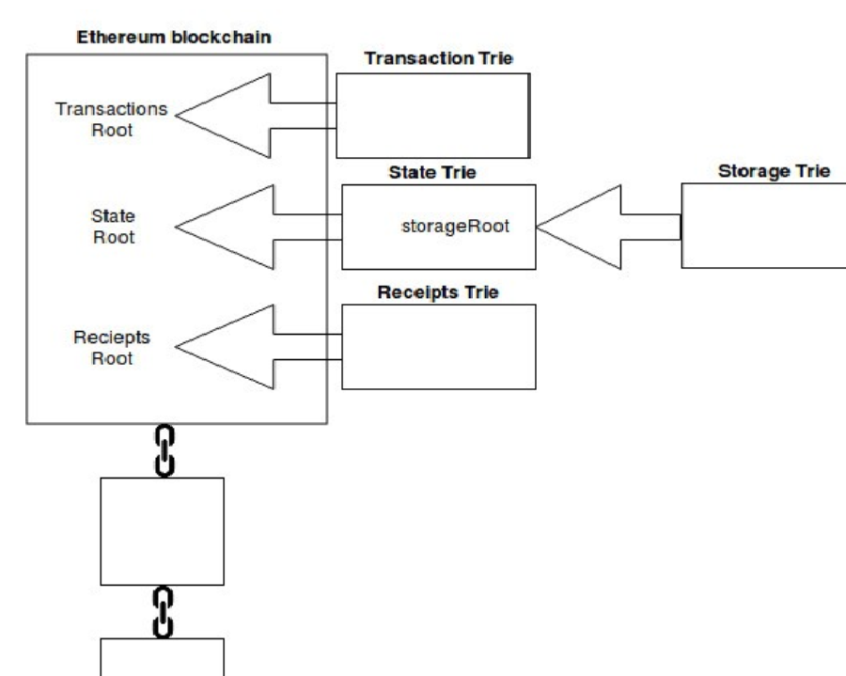
State of blockchain during execution
While the Ethereum virtual machine is running, its full computational state can be defined by the tuple (block_state, transaction, message, code, memory, stack, pc, gas), where block_state is the global state containing all accounts and includes balances and storage.
While the Ethereum virtual machine is running,
its full computational state can be defined by
the tuple (block_state, transaction, message, code, memory, stack, pc, gas),
where block_state is the global state containing all accounts and includes balances and storage,
Balances and storage are Patricia Merkle Tries of balances of accounts, and storage of contract accounts.
Credit: https://medium.com/cybermiles/diving-into-ethereums-world-state-c893102030ed

Slide 10
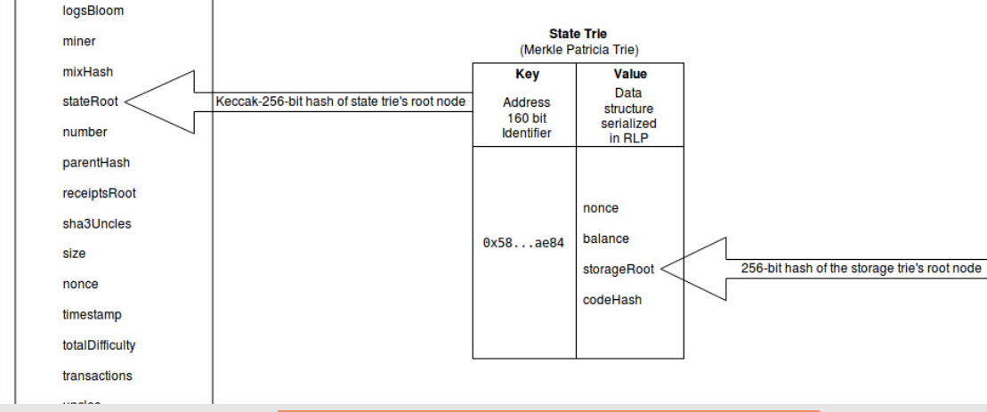
State of blockchain during execution
While the Ethereum virtual machine is running, its full computational state can be defined by the tuple (block_state, transaction, message, code, memory, stack, pc, gas), where block_state is the global state containing all accounts and includes balances and storage.
Credit: https://hackernoon.com/getting-deep-into-ethereum-how-data-is-stored-in-ethereum-e3f669d96033
Note the key-value store
Note the all the storage variables of the smart contract
stored in a Merkle trie.

Slide 11
Applications
Three types of applications:
Pure cryptocurrency, financial systems for digital money, and tokens
sub-currencies, financial derivatives, hedging contracts, savings wallets, wills, and ultimately even some classes of full-scale employment contracts.
Semi-financial applications, where money is involved but there is also a heavy non-monetary side to what is being done;
Market place that we discussed in Lab1
Non-financial applications
Online voting and decentralized governance

Slide 12
Public-key Cryptography
Dr. B. Ramamurthy
Research Associate Professor
bina@buffalo.edu
http://www.cse.buffalo.edu/~bina

Slide 13
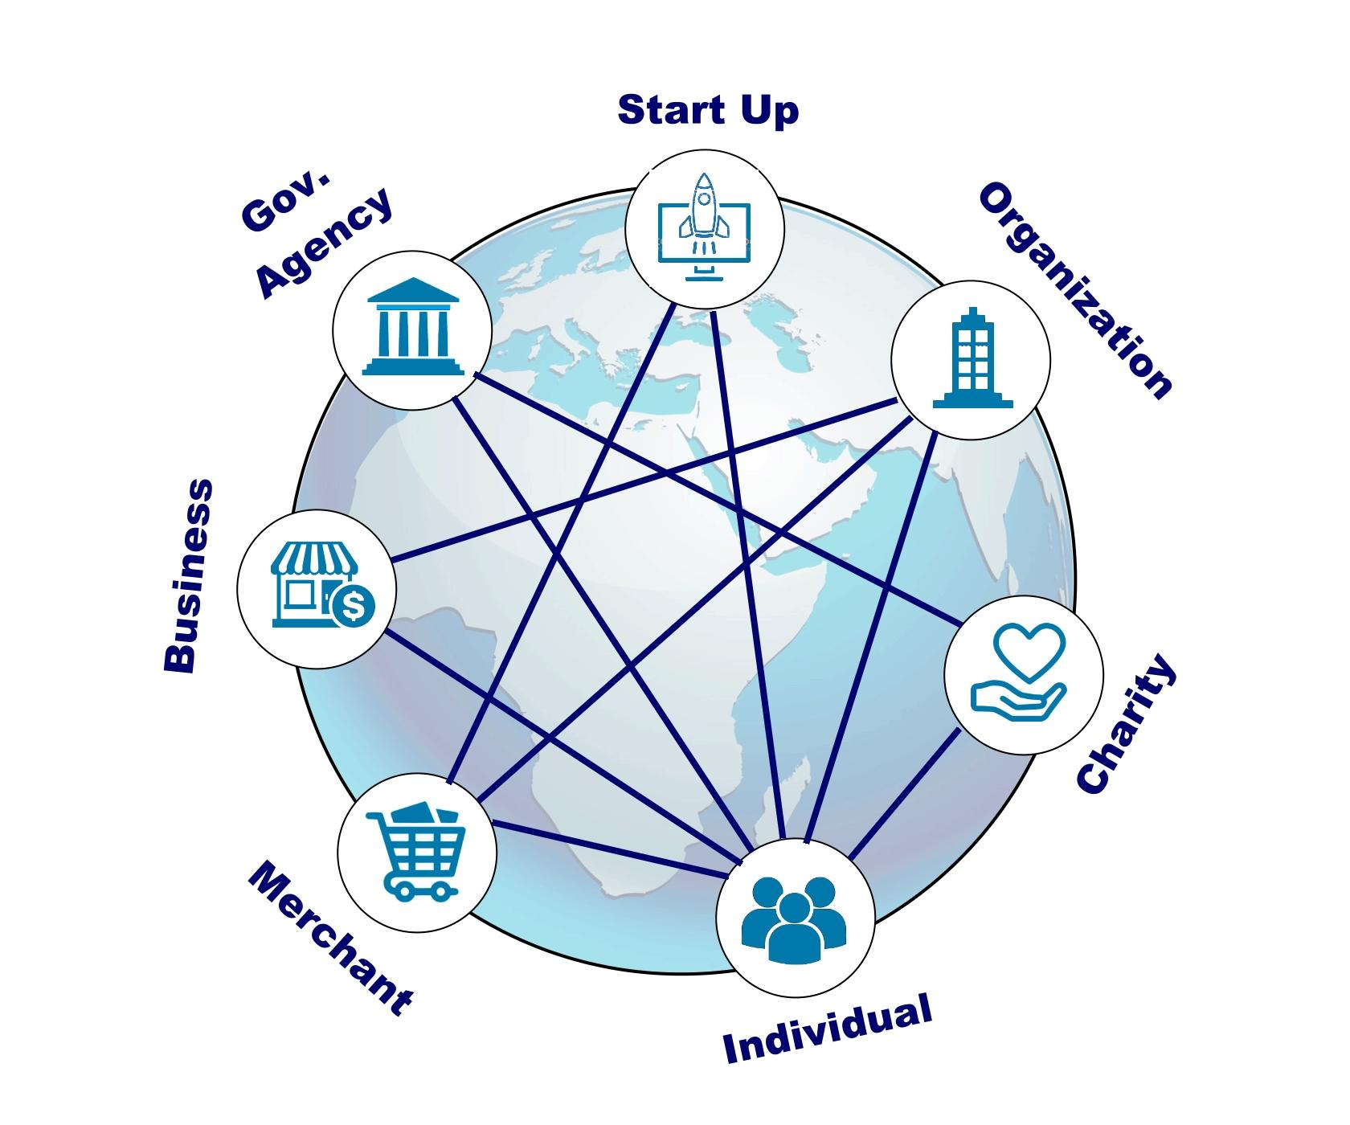
Motivation
Recall that Blockchain’s decentralized network participants are not necessarily known to each other. Their credentials cannot be checked by conventional means to assign them a username and a password!
They can join and leave the chain as they wish.
They operate beyond the boundaries of trust.
Given this context,
--How do you identify the participants?
--How do you authorize transactions?
--How do you detect forged or faulty transactions?
We can address all of the above using public-key cryptography algorithms that we will discuss in this lesson.
Notes:
Traditional {username, password} is not possible since we are in any one trusted domain.

Slide 14
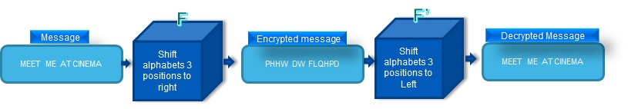
Symmetric (Shared) Key Cryptography
Same key is used for encryption and decryption: so it is called “symmetric key”
Data -- F(key) -- encrypted data -- F’(key) --original data
Example: Caesar encryption is a simplest one where alphabets of a message are shifted by a fixed number (key); F is “shift” by 3.
This key and the function are typically much more complex in a real application.
However symmetric encryption has issues: (i) It is easy to derive the “secret” key from the encrypted data and (ii) key distribution: how do you pass the key to the participants transacting?
These issues are further exasperated in a Blockchain’s decentralized network.
Notes:
Consider “Meet me at Cinema” you add 3 to every letter there to encrypt it and
Your receiver decrypts it using the same 3 but -3 to view the original message.

Slide 15
Private-Public Key Cryptography
Instead of a shared secret key, use two different keys:
Let {b, B} be {private, public key} pair for a participant in Buffalo, New York, USA.
Let {k,K} be the pair for participant in Kathmandu, Nepal.
Public key is published; Private key is kept safe/locked typically using a passphrase.
And...the pair works as follows:
b
B
k
K
Notes:
Please note that we will represent private key with lighter shade of a color and public key with darker shade of the color.

Slide 16
Private-Public Key Pair (b, B) : Operation
Encryption X= F(data, key b)
Decryption
data
data
X
data = F(X, key B)
Private key b
Public key B
The encrypting function holds two properties for the key pair (b,B):
F(b, F(Data,B)) → Data
F(B, F(Data,b)) → Data
The public-private key pair has the unique quality that when a message is encrypted with the private key it can be decoded with public key and vice-versa. Private key is kept secure and safe while publishing the public key for various purposes.

Slide 17
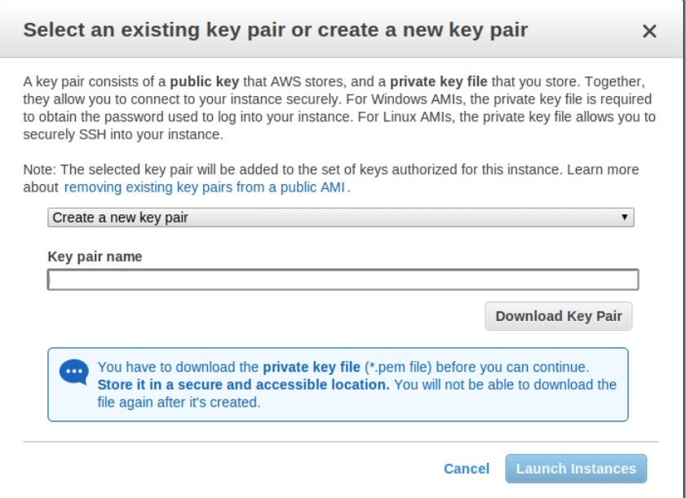
Public Key Cryptography : RSA algorithm
A popular implementation of public-private key is the Rivest-Shamir-Adelman (RSA) algorithm:
You can generate a pair of keys called {private, public}
keys using any of these applications:
--putty-keygen on Windows
--ssh-keygen on linux and on mac
Or using code embedded within other applications.
Common application for RSA: passwordless user authentication, for example for accessing a virtual machine on amazon cloud.
Notes:
Puttykeygen process demo

Slide 18
Elliptical Curve Cryptography (ECC)
Though RSA is commonly used in distributed systems, the Blockchains need a more efficient and stronger algorithm.
Efficiency is a critical requirement since public-key pair is used in many different situations in a Blockchain.
Elliptic Curve Cryptography (ECC) family of algorithms is used in the Bitcoin as well as Ethereum blockchain for generating the key pair.
Why ECC, not RSA?
ECC is stronger than RSA for given number of bits.
256-Bit ECC key-pair is equivalent in strength to approimately 3072 bit RSA key-pair.
Moreover, this 256-bit structure allows for Blockchain operations (and hardware) to be optimized to 256-bit integer arithmetic.
Notes:
Thus ECC is stronger than RSA for a given number of bits.

Slide 19
Example: Authenticate the Sender & Receiver
We will examine just one common use of asymmetric key encryption:
Let’s say a participant Buffalo wants to transact with a participant in Kathmandu.
Instead of sending just a simple message, participant in Buffalo will send a transaction signed by Buffalo’s private key (b) and encrypted by Kathmandu’s public key (K):
E(K,E(Tx,b))
Kathmandu will first decrypt the above using its private key (k) and then use Buffalo’s public key (B) to decrypt the signed transaction:
D(k, E(K,E(Tx,b)) → E(Tx,b)
D(B,E(Tx,b)) → Tx
Notes:
This sequence of operations, will (i) let Buffalo authorize the transaction by signing using its private key, (ii) encrypt the message with Kathmandu’s public key so that only Kathmandu can decrypt it using its private key and (ii) authenticate that Buffalo and no imposter of Buffalo is sending the message by decrypting it using Buffalo’s public key.

Slide 20
Example
b
B
k
K
Tx
K
Buffalo’s Keys Katmandu’s Keys
b
Tx
Tx
Tx
Tx
k
B
E(K,E(Tx,b))
D(k, E(K,E(Tx,b)) →E(Tx,b)
D(B,E(Tx,b)) → Tx
These are the keys we refer to as private-public keys in blockchain development.
Notes:
A tx can be encrypted with private key of sender: authentication of sender
Then encrypted with public key of receiver: authentication of receiver
Transmitted.
Decrypted only with private of receiver.
Then with the public key of sender.

Slide 21
Hashing
Dr. B. Ramamurthy
Research Associate Professor
bina@buffalo.edu
http://www.cse.buffalo.edu/~bina

Slide 22
Basic requirement of a hash function
Algorithm chosen for a hash function should be
(i) one way function
(ii) It should be collision free or be exhibit extremely low probability of collision.
The first requirement is to make certain that one cannot derive the original items hashed from the hash value. (Given a function for f(x) it easy to evaluate y = f(x); But given y, it is infeasible to find x.)
The second requirement is to make sure that the hash value uniquely represents the original items hashed.
These requirements are achieved by choosing a strong algorithm such as Secure Hash algorithms (SHA) and by using an appropriate number of bits in the hash value. Most Blockchains use 256 bits hash.

Slide 23
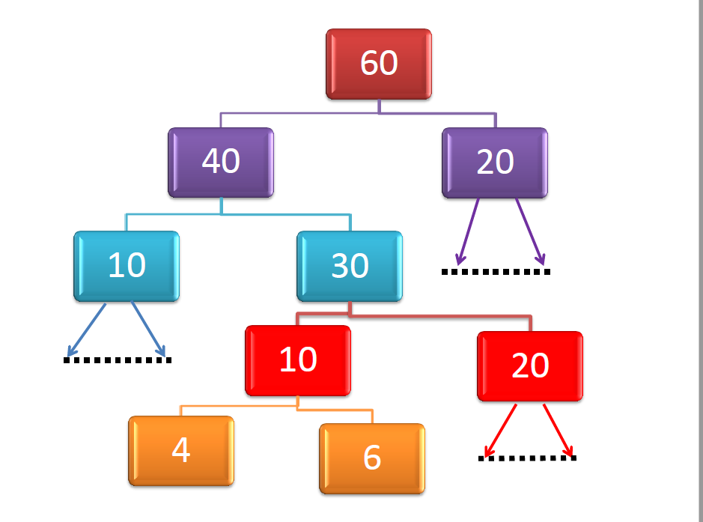
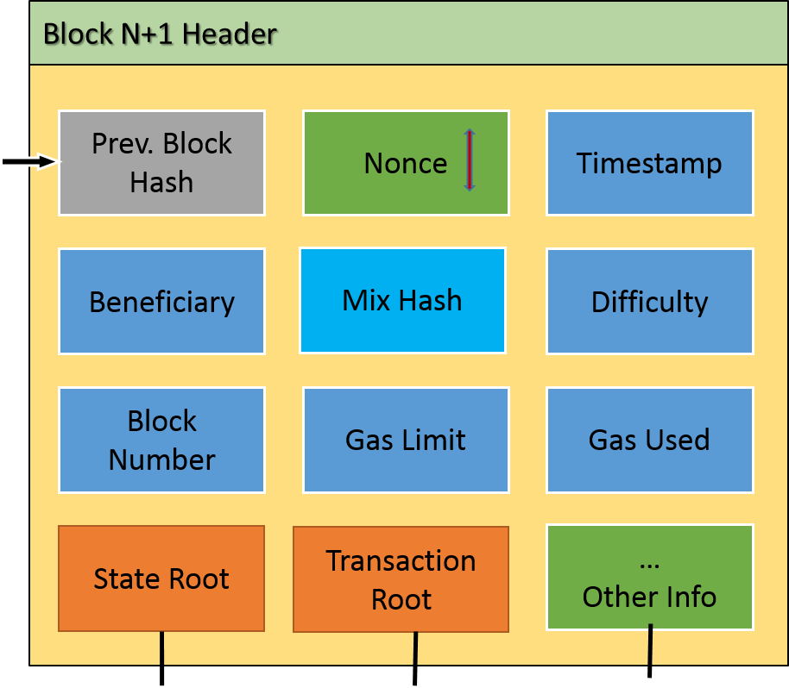
What is hashing?
A hash function or hashing transforms/maps an arbitrary length of input data value to a value of fixed length output value.
Document of
any length
Hash function
hashValue
256 bits
Data structure of any size
Hash function
hashValue
256 bits
Hash function
hashValue
256 bits
Ethereum Block header
Notes:
Any data: tree, text, datastore, blockchain block can be “mushed” by algorithms into fixed code: in Blockchain’s case 256 bit code.

Slide 24
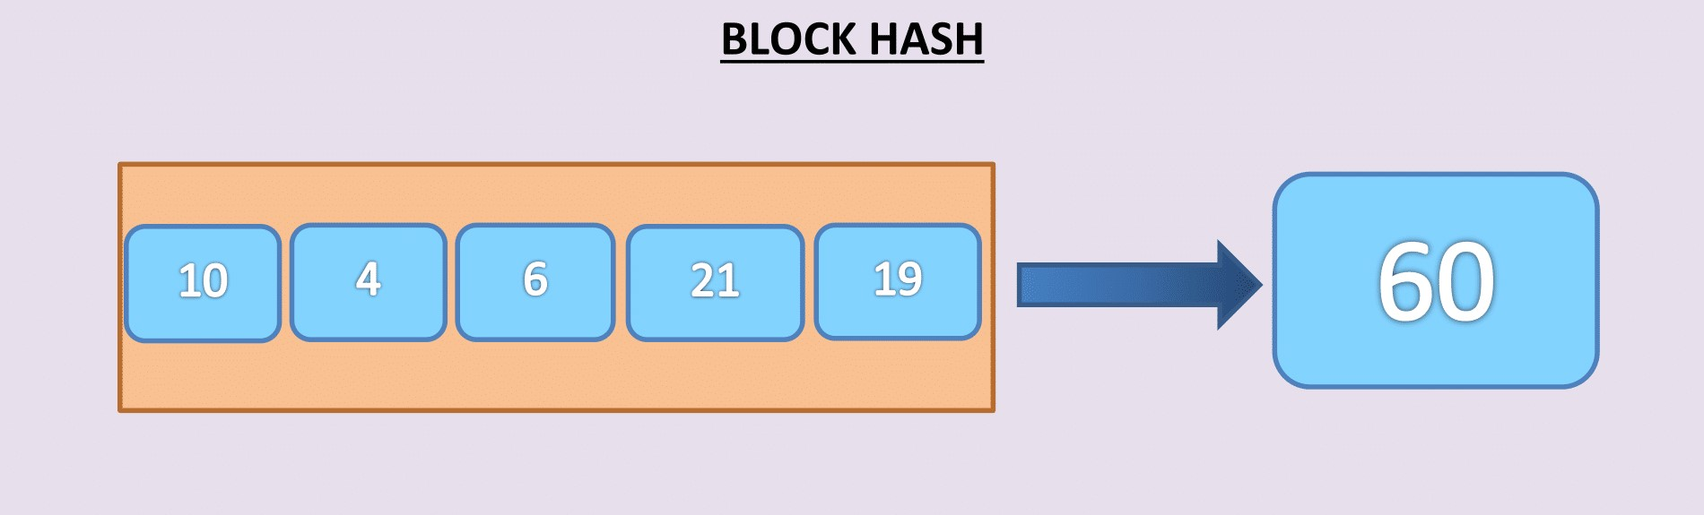
Simple Hash vs. Merkle Hash Tree
Notes:
Actual hashing functions are quite complex. Here we illustrate “simple hashing’ and “tree hashing” with “add” as the hash function. Once again actual hashing functions are quite complex.

Slide 25
Simple vs Hierarchical Hash
Hashing is indeed very versatile.
When do you use a hierarchical tree-structured organization for finding the hash?
--When you have a fixed number of items to be hashed, such as the items in a block header, use the simple hash.
--When the number of items is variable: number of transactions, number of states, number of receipts, use hierarchical structure for computing the hash.
Hierarchical structure helps the efficiency of repeated operations such as transaction verification and state changes from one block to the next.

Slide 26
How good is a 256 bits hash?
Both Bitcoin and Ethereum use 256 bit hash.
A 256-bit hash value space is indeed very large; 2²⁵⁶ possible combinations of values: that is approximately: 10⁷⁷ values: 10 followed by 77 zeros.
100000000000000000000000000000000000000000000000000000000000000000000000000000000000000000000000000000000000000000000000000000000000000000000000000000000000000000000000000000000000000000000
Odds of a meteor hitting your house is higher than generating two of same hash value (256 bit) when applying this algorithm.

Slide 27
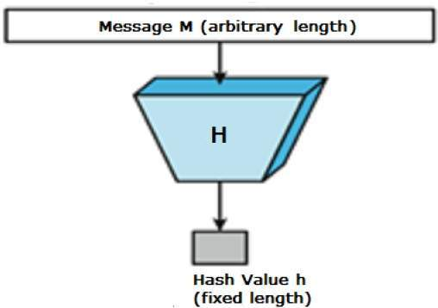
Where is Hashing used in the Blockchain?
Hashing algorithm is used in techniques for
digital identity or account address,
digital signatures,
transaction hash,
State hash, and
block header hash.
b
B
A

Slide 28
Some Uses of Hashing in the blockchain process
--It can be used for digitally signing a transaction. This digital signature will be a hash of the transaction and encrypted with a private key of the participant.
--It can also be used to detect tampering of the data. Any modification of a transaction will result in a different hash value and will not match the original hash value, during the verification process and are rejected.
--It provides a single concise representation of varying number and types of data fields in a block or a transaction. Instead of checking many different data elements you verify and validate just one value, the hash value.

Slide 29
Digital Signing of Data
Hashing and cryptography are innovatively integrated to implement “digital signing of data” or secure hashing. This is illustrated below:
Data is hashed (Hash(data)) and encrypted (Encrypt(Hash(data))). The receiver gets the block shown at the right end: Original data + secure hash digitally signing the document.
Receiver can recompute the hash of the data received and compare with the received hash to verify the integrity of the document.
Original Data
(e.g. Transaction)
Original Data
(e.g. Transaction)
Dh= Hash ()
Dhb= Encrypt(Dh, b)
Dhb
Digital
signature
Notes:
Note that the document is not encrypted.

Slide 30
Transactions in a Block
A typical block has about 2000 Txs in Bitcoin and about hundreds of Txs in Ethereum. We need an efficient way to detect tampering and validate the transactions efficiently.
Trick is in a “tree structure” and an associated hash: Merkle Patricia Tree hash.
Hashes of the transactions in a block are processed in a tree structure. (We will discuss only the tree structure here. The concept can be expanded to a trie structure.)
The Merkle tree hash is computed by pairwise hash computation starting from the leaf nodes. The final root hash is the hash of the transactions in the block.
Notes:
SHE256 RIPEMD160 hash

Slide 31
Block Hash
Block hash is an indeed important item in a Blockchain:
It is computed by applying SHA256 on all the items of the Block header.
Block has serves multi-purpose including:
For verifying the integrity of the Block and the transactions
For forming the chain by embedded previous block hash in the header

Slide 32
Simple Hash of the Ethereum Block
SHA 3 Hash
256-bit Block Hash
Block header items are sequentially hashed to obtain the final hash. Keccak-hash

Slide 33
Integrity of the Chain
Chain
invalid
Modify
Block
Block hash is very critical for the integrity of the
Chain.
The “link” that forms the chain is indeed the Block hash.
Every block has the hash of the previous block thus forming the chain.
If anybody tampers with a block, its hash changes, resulting in the mismatch of the hash value and a broken or invalid chain.
This enforces the immutability of the chain.
Block
Block

Slide 34
Extra slides

Slide 35
Blockchain: Validation & Verification
Account
Transactions
Block
Validate &
Gather, Execute, Broadcast
Transactions
Consensus,
Broadcast,
Verify &
Confirm
Block
Block
Block
Notes:
Recall that verification and validation are very critical steps before adding a bloc to the existing trusted chain.

Slide 36
The Trust Trail
Txs
Secure Blockchain
Txs
Validate Txs
Verify Gas,
Resources
Execute Txs
Form Block;
Consensus
Process
Finalize &
Broadcast
Block
Others Verify Block
Add block
to the
Blockchain,
Confirm Txs
Notes:
The trust trail: Vlaidate Tx, Verify gas, resources, gather tx, Execute tx to get new state,form block, work towards consensus, winner finalizes the block, everyone add the block to the chain and confirm tXs. We will examine each of these steps.

Slide 37
Validate Transactions
Txs
Secure Blockchain
Txs
Validate Txs
Verify Gas,
Resources
Execute Txs
Form Block;
Consensus
Process
Finalize &
Broadcast
Block
Others Verify Block
Add block
to the
Blockchain,
Confirm Txs
In the case of Bitcoin, there are about 20 criteria that are to be checked before a transaction is validated as discussed in Module 1.
Similarly in the case of a Ethereum transaction, the syntax, the Tx signature, timestamp, nonce, gas limit, and sender account balance are validated before execution. The fuel or gas points and other resources available for smart contract execution are also validated.
Tx signatures and hash are also validated.

Slide 38
Transaction Confirmation
1. User submits a transaction and gets back transaction hash as a receipt immediately. User can use eth.getTransaction(<hash>) to view the metadata of the transaction.
2. This transaction goes into the pool of transactions
3. Miners have to choose this transaction and validate. If it’s a validate transaction he adds it to his block and starts solving the puzzle
4. If the winner miner’s block contains the transaction which the user submitted then it goes into blockchain else it will again go into the transaction pool.
5. After the transaction is confirmed when we query using the eth.getTransactionReceipt(<hash>) it will return the details of the transaction like who mined it, when it was mined, gas spent, block number of the transaction etc, it will return null if the transaction was not confirmed.

Slide 39
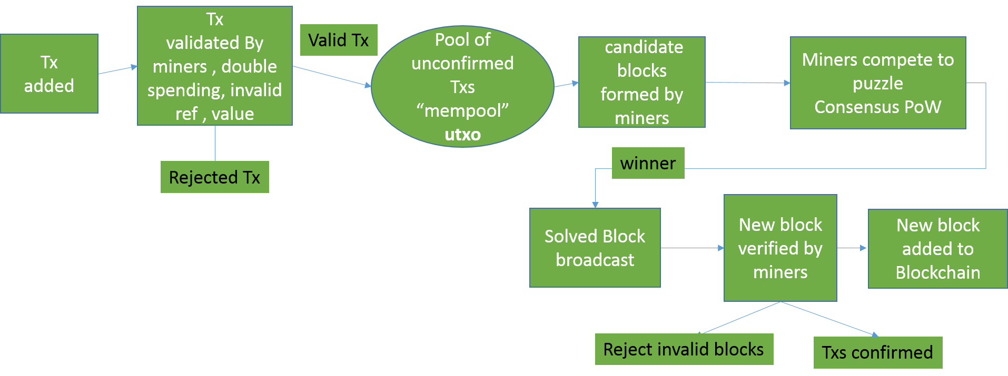
Block Creation Process
Notes:
Block creation process.
Tx are initiated by nodes. They are validated by miners. Rejected or accepted to a pool. Miners then form block from tX, and compete to solve a puzzle with the hashes of the block header elements. The miner who solves the puzzle first gets to create the block. The block is broadcast and verified by others. Then added to the chain. Tx are confirmed.

Slide 40
Summary
We examined important concepts that enable the Ethereum blockchain including cryptography and hashing.
Also Ethereum protocol provides functions for various functions; Keccak, etc.
Look at the links provided to study for midterm.

